Slide 1

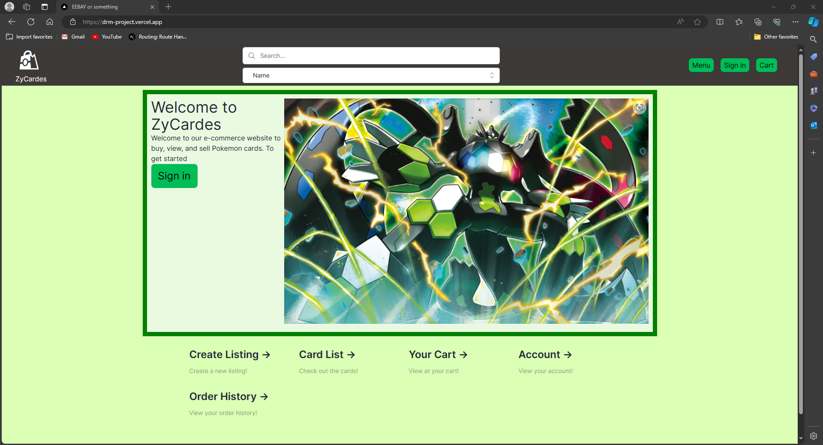
ZyCardes
DRM: Diego, Ryan, Mariam

Slide 2

Project Overview
drm-project.vercel.app
Notes:
Our project this semester was to build an e-commerce website for pokemon trading cards. We wanted to create a platform where users will be able to find, purchase, and list cards.

Slide 3
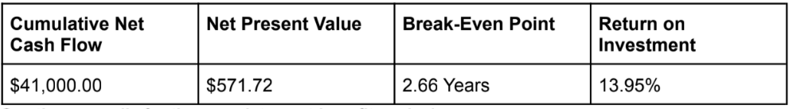
Business Purpose
Capture a portion of the Pokemon trading card e-commerce market.
Notes:
So as a business we wanted the system to help capture a portion of the trading card e-commerce market.
According to Statista Market Insights, the U.S. card games market had about $818 million in revenue during 2023 and it had approximately $2.75 billion globally.
The potential revenue this project could generate could be high and sustained if it can successfully compete in these markets. The operating costs for maintaining this system could be fairly minimal, and as the product matures, more investment in infrastructure would help bring costs down even more.
Last semester, we conducted a comprehensive analysis, calculating summary statistics spanning a three-year period for the potential Cumulative Net Cash Flow, Net Present value, Break-Even point, and Return on Investment. We based our calculations on sample data reflecting the industry's growth trajectory.

Slide 4
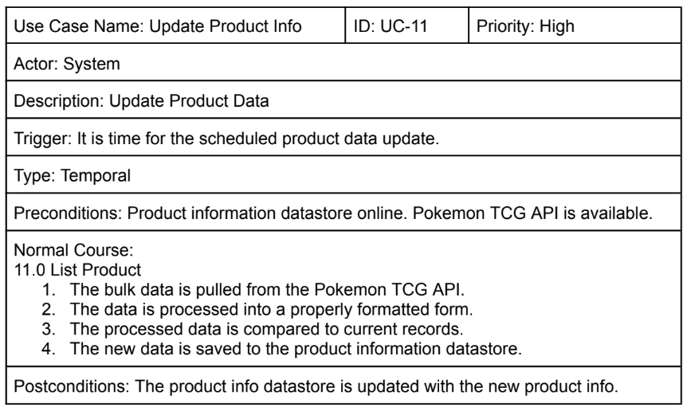
Development Process
Started off with agile methodology, specifically Scrum.
Ended up using iterative development.
Notes:
When developing our application we originally started off doing a agile methodology, specifically scrum. So all our user stories were kept in Jira and we were assigning tasks to each other every week.
This methodology did not work out for us, it ended up creating a lot of unnecessary overhead for us and since we were such a small group with a clear concept of what we wanted to build, iterative development ended up working best for us. Last semester we spent a lot of time creating a clear plan and image for project, so it was easy for us to break down the project into series that we developed sequentially.

Slide 5

Technical Architecture

Slide 6









Frontend
APIs
Backend
Pokemon TCG API
Notes:
Our team decided to utilize technologies that we felt were relevant to web development in industry today.
Next.js: enabled server-side rendering and provided a seamless development experience for constructing user interfaces.
ReactJS: used to construct user interfaces. It helped in creating dynamic and interactive components on the front-end.
Tailwind CSS is a CSS framework that we used to style the components of the website.
NextAuth is a library for authentication in Next.js applications, this provided us to create a secure way to implement user authentication and authorization.
The project was primarily written in Javascript. Some components were written Typescript.
PostgreSQL served as the primary data storage solution, it ensured the structured and secure storage of product, sales, and user-related information.
Vercel was our cloud hosting platform that provided us with the tools, workflows, and infrastructure needed to build and deploy the web app.
Pokemon TCG API: used this for the pokemon card datasets, including images, card id, attacks, hp.

Slide 7

Features and Functionality

Slide 8
Features and Functionality
Ability to create, view, and edit product listing.
Product search and display capabilities.
Order history display.
Access to card pricing information.
Managing shopping cart.
Account creation and deletion.

Slide 9

Code Walkthrough
Notes:
Oauth With Github
Database Structure
Life of Search Query

Slide 10
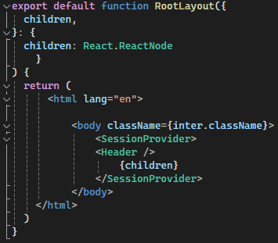

Oauth with GitHub
Entire app wrapped in NextAuth’s SessionProvider.
Only one provider has been made available so far, GitHub.
Credentials are handled on GitHub’s servers, only email addresses are used in data operations on our server.

Slide 11
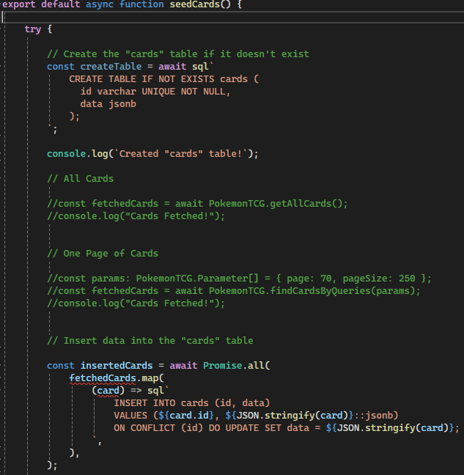
Database Structure
Our project uses Vercel PostGres for our database.
JSON objects provided by the Pokemon TCG API were used to populate database with card data.
Listings are stored in a separate table linked to the product IDs of the cards.
Items in carts and purchased items are stored in a cart_listing and order_history table.

Slide 12
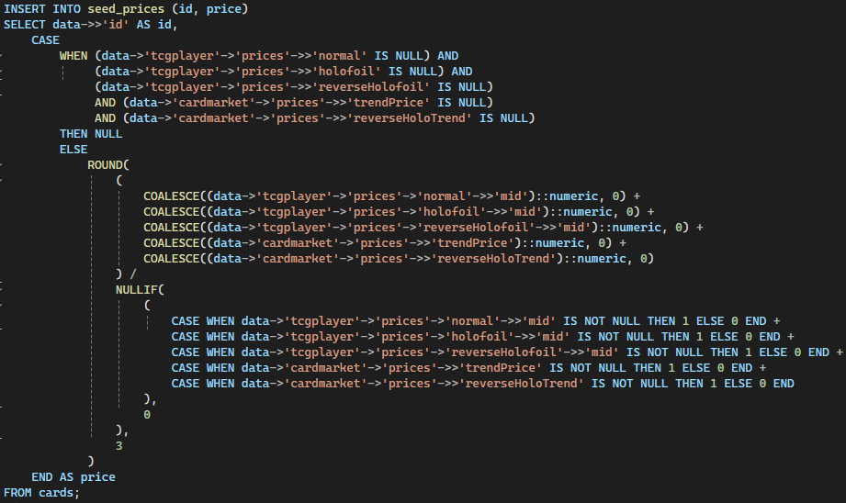
Database Structure
Pricing was added to the cards based on aggregated data contained within the Pokemon TCG APIs objects.
Prices were averaged from many different providers such as TCGPlayer and CardMarket.

Slide 13
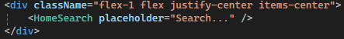
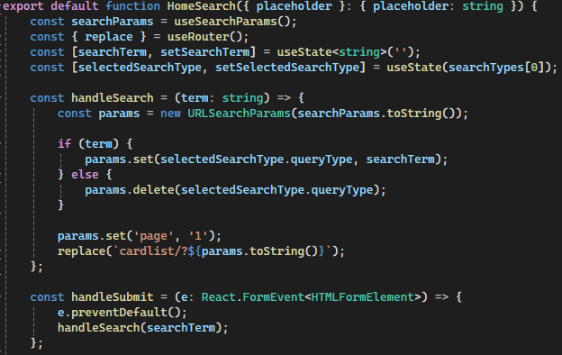
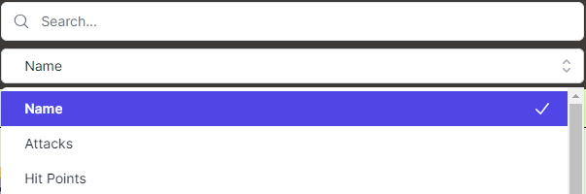
Life of Search Query
User types into the provided form and select search type from a dropdown menu.
When submitted, the parameters are set to include all search terms that have a unique selectedSearchType.
Old parameters are read from the URLs query string.

Slide 14
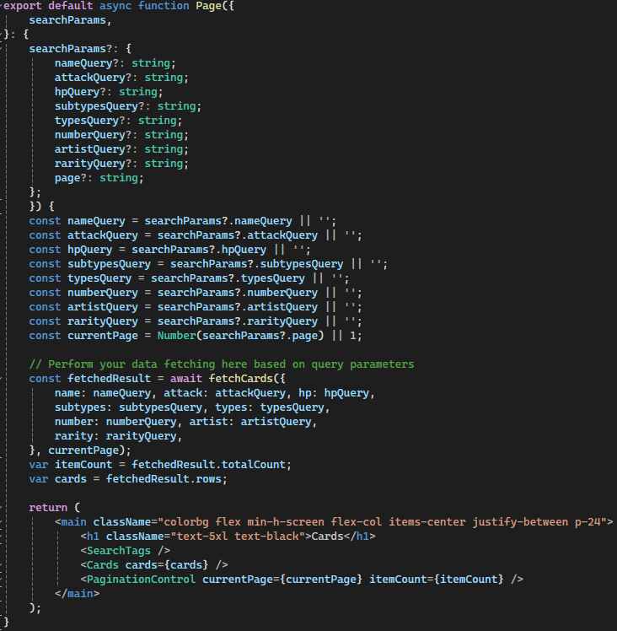
Life of Search Query
When a search is submitted, the user is redirected to the card list page.
The page gathers the queries from the URL and passes them to the fetchCards database operation.
The fetched result is broken into two pieces, itemCount (page count for pagination controls), and cards (actual card data).

Slide 15
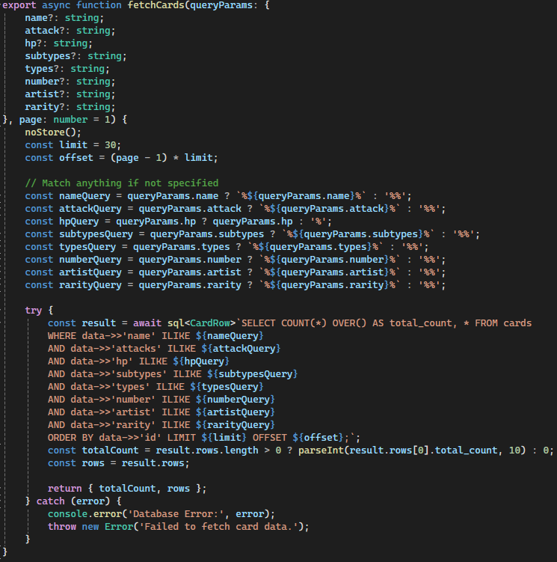
Life of Search Query
The fetchCards function queries the database based on passed in parameters.
Returns count of results and the cards themselves.
Wildcard characters and a long SQL query are used to allow for additive search terms (search by more than one search type).

Slide 16
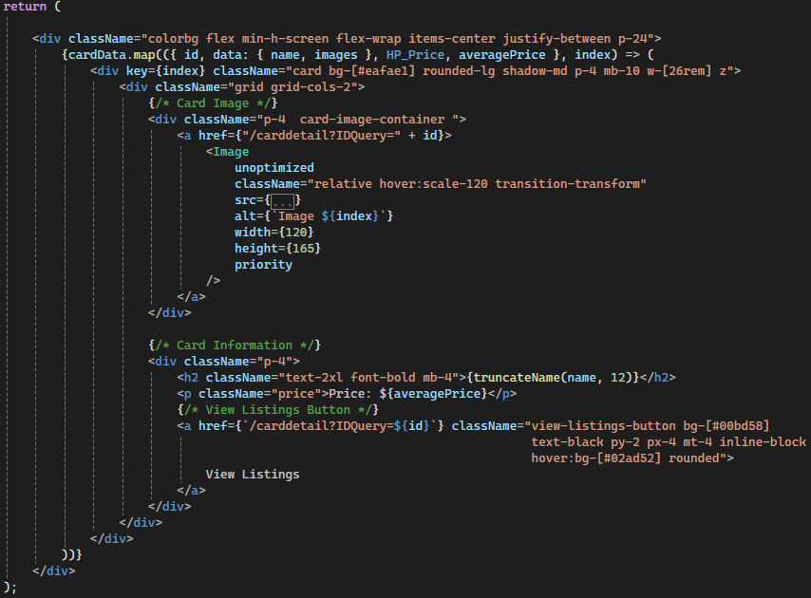
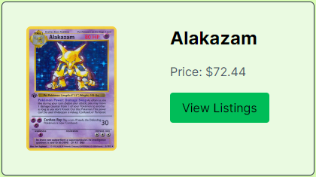
Life of Search Query
The page of fetched card data is passed to the cards component.
The component renders each of the cards in the list along with their buttons and styling.
System is prepared to accept user pricing data with only a few small changes.

Slide 17
Testing

Slide 18
Testing
Unit Testing- We didn’t do it much because it was all done with the Next.js framework.
User Testing- We asked people to try out our website and got feedback.
Integration and System Testing- We made sure that all modules correctly worked with one another through user interface testing, use-scenario testing, and data-flow testing.
Prepared for alpha acceptance testing- Got regular feedback from our project sponsor.
Fixed inconsistent colors
Added additive search and search tags
Mobile friendly but there were time constraints

Slide 19
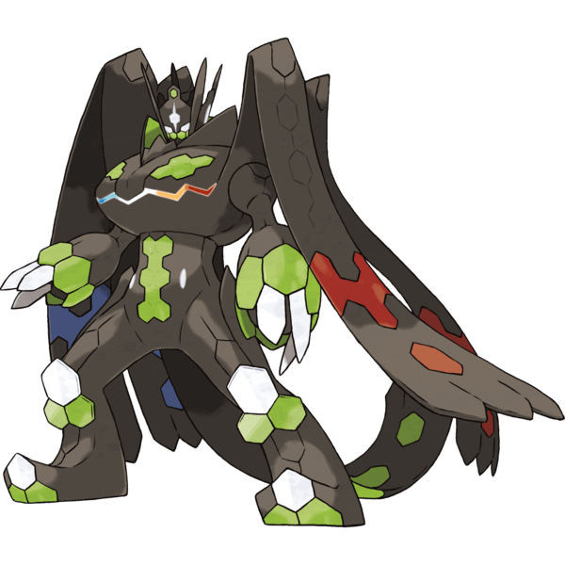
Demo Time!
Notes:
We used colors that matched our main pokemon, zygarde. Different types of green and black
All buttons are rounded and when hover color changes to show you’re on it.
Home page looks welcoming, inviting users to begin exploring.

Slide 20
Questions?

